Slide 1

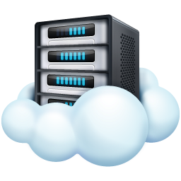

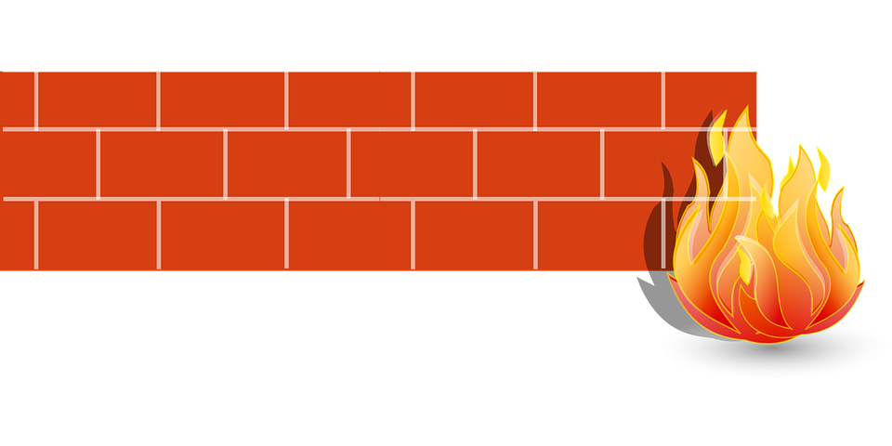

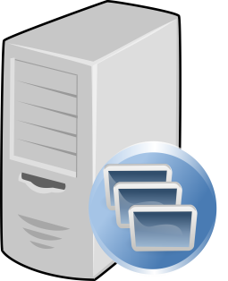
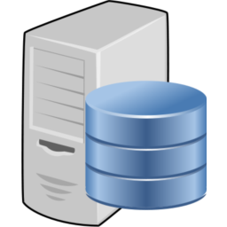
Version 7
RR DB Log In
Company email
Simple or complex password
Customer Internal Network
Internet (Microsoft Azure)
UI Interface Server
url: rapidreconciler.getgsi.com
url*: rrprod-[companyname].getgsi.com
*(url assigned during install)
End User PC
Google Chrome
Microsoft Edge
Internet Explorer
FireFox
Safari
JDE Business Data
RR Data Services
UI Forms
HTTPS Comms
Log In
Port Range 32145 -49152
Application Server Firewall
Port number determined during installation (1 per RR database). Port(s) must be opened on internal network.
RR Servers
IP: 168.62.49.184
DNS: rr-valc-spa.cloudapp.net
IP: 52.170.255.174
DNS: rr-spa.cloudapp.net
JMS Comms
RR Data Services
SQL log in
(SQL Authentication)
Integration Services
JDE database log in (Read Only)
RR Application Server
RR Agent (outbound access to RR servers)
RR Data Services (internal)
SQL Server Management Studio
BIDS or SQL Data Tools
Windows admin account for installation and package deploy
RR Database Server
MS SQL 2012 +
Integration Services
RR app log in (SQL Auth)
Windows admin account set up in SQL Server for package deploy
JDE Database Server
Read only credentials Password set to not expire

Slide 2

Internal Network Only
JDE log in
log in (OLEDB connection)
End User
- Or -
RapidReconciler Client Software Installed
RR Database Server
MS SQL 2012 +
Integration Services *
JDE Database Server
Read only credentials Password set to not expire
RapidReconciler Cloud Database
o External, internal IP of app server
o Internal IP address of db server(s)
o RR SQL creds of the database server(s) (encrypted)
o RR SQL db names and port numbers
o RR usernames and passwords (encrypted)
o JDE company numbers and names
*Optional SSIS Server
Integration Services
Version 6

Slide 3
Version 7
RR DB Log In
Company email
Simple or complex password
Customer Internal Network
Internet (Microsoft Azure)
UI Interface Server
url: rapidreconciler.getgsi.com
url*: rrprod-cantex.getgsi.com
*(url assigned during install)
End User PC
Google Chrome
Microsoft Edge
Internet Explorer
FireFox
Safari
JDE Business Data
RR Data Services
UI Forms
HTTPS Comms
Log In
Port Range 32145 -49152
Application Server Firewall
Port number (40674) determined during installation (1 per RR database). Port(s) must be opened on internal network.
RR Servers
IP: 168.62.49.184
DNS: rr-valc-spa.cloudapp.net
IP: 52.170.255.174
DNS: rr-spa.cloudapp.net
JMS Comms
RR Data Services
SQL log in
(SQL Authentication)
Integration Services
JDE database log in (Read Only)
RR Application Server
RR Agent (outbound access to RR servers)
RR Data Services (internal)
Windows admin account for installation and package deploy
External IP: 64.72.63.214
Internal IP: 192.168.2.42
Server Name: CTXRAPIDRECON
RR Database Server
MS SQL 2012 +
Integration Services
SQL Server Management Studio
BIDS or SQL Data Tools
Windows admin account set up in SQL Server for package deploy
DB: RapidReconciler_Prod
Name: CTXREDMAP
IP: 192.168.2.41:1433
SQL Log in: rruser
To do:
Oracle drivers
JDE Database Server
Read only credentials Password set to not expire
Oracle
Listener: JDEORCL
Log In: rapidrec
Password: TBD
Cantex

Slide 4
Version 7
RR DB Log In
Company email
Simple or complex password
Customer Internal Network
Internet (Microsoft Azure)
UI Interface Server
url: rapidreconciler.getgsi.com
url*: rrprod-carrier.getgsi.com
*(url assigned during install)
End User PC
Google Chrome
Microsoft Edge
Internet Explorer
FireFox
Safari
JDE Business Data
RR Data Services
UI Forms
HTTPS Comms
Log In
Port Range 32145 -49152
Application Server Firewall
Port number (39830, 41750) determined during installation (1 per RR database). Port(s) must be opened on internal network.
RR Servers
IP: 168.62.49.184
DNS: rr-valc-spa.cloudapp.net
IP: 52.170.255.174
DNS: rr-spa.cloudapp.net
JMS Comms
RR Data Services
SQL log in
(SQL Authentication)
Integration Services
JDE database log in (Read Only)
RR Application Server
RR Agent (outbound access to RR servers)
RR Data Services (internal)
Windows admin account for installation and package deploy
External IP: 52.251.67.96
Internal IP: 10.181.36.95 (201)?
Server Name: VMC7222PA029
RR Database Server
MS SQL 2012 +
Integration Services
SQL Server Management Studio
BIDS or SQL Data Tools
Windows admin account set up in SQL Server for package deploy
DB: RapidReconciler_KF
Name: VMC7222PA029.carcgl.com\RapidReconciler
IP: 10.181.36.95
SQL Log in: rruser
JDE Database Server
Read only credentials Password set to not expire
SQL Server
VMC10134PJ052\JDEMIRROR
DB: AMJDE_KSPD92
Log In: UDETRRCON1
KFL

Slide 5
VMC7222PA029 (Existing Server)
Internet (Microsoft Azure)
Agent Configuration
UI Interface Server
External IP: 52.251.67.96
Internal IP: 10.181.36.95
RR Agent
Scenario 1
New RR Agent Customer Server
Name
External IP ?
Internal IP ?
End User PC
UI Forms
Configure new VALC client at GSI.
Move user accounts as applicable.
Update Cloudfare IP with new server info.
Log In
(Existing DB Server)
Autronica, De-Tronics DBs and SSIS packages
IP: 10.181.36.201
JMS Comms
Integration Services
JDE database log in (Read Only)
RR Licensing Servers
JDE Database Server
VMC10134PJ052/JDE Mirror
SQL Server
Will move in future
Scenario 2
New RR DB Server
Autronica, De-Tronics DBs and SSIS packages
Internal IP ?
Backup, restore De-Tronics and Autronica databases.
Copy, reconfigure, and re-deploy SSIS packages.
Remove De-Tronics, Autronica from existing server.
Test connectivity.
Customer Internal RR Network
(De-tronics/Autronica)

Slide 6
Internal Comms
External Comms
UI Interface Server
url: rapidreconciler.getgsi.com
url*: rrprod-[companyname].getgsi.com
*(url assigned during install)
Port 443
End User PC
UI Forms
Port 41750
Log In
New RR Agent Server
AUSXNETRRP01
74.235.18.154
10.181.210.154
JMS Comms
Port 1433
Port 1433
RR Licensing Servers
IP: 168.62.49.184
DNS: rr-valc-spa.cloudapp.net
IP: 52.170.255.174
DNS: rr-spa.cloudapp.net
New RR DB Server
AUSXNETRRDB01
10.181.220.171
DMZ
Backup, restore KF database.
Enable Sql Agent Job
Port 1435
New JDE Database Server
AUSJDEDBP01.kiddefenwal.net,1435
IP 10.181.50.111
Internet (Microsoft Azure)
Customer Internal RR Network
(Kidde Fenwal)

